Slide 1
RETAIL SALES ANALYSIS DASHBOARD

Slide 2
INTRDODUCTION
This project focuses on analyzing retail sales data using Power BI to understand business performance

Slide 3
OBJECTIVES
1)Analyse sales and profit
2)Identify top products
3)Understand regional performance
4)Create interactive dashboards

Slide 4
DATASET
THE DATASET CONTAINS INFORMATION ABOUT
1)SALES
2)PROFIT
3)REGION
4)QUANTITY
5)CATEGORY

Slide 5
Dashboard overview
CARDS
1)TOTAL SALES
2)TOTAL PROFIT
3)TOTAL QUANTITY
4)TOTAL PROFIT

Slide 6
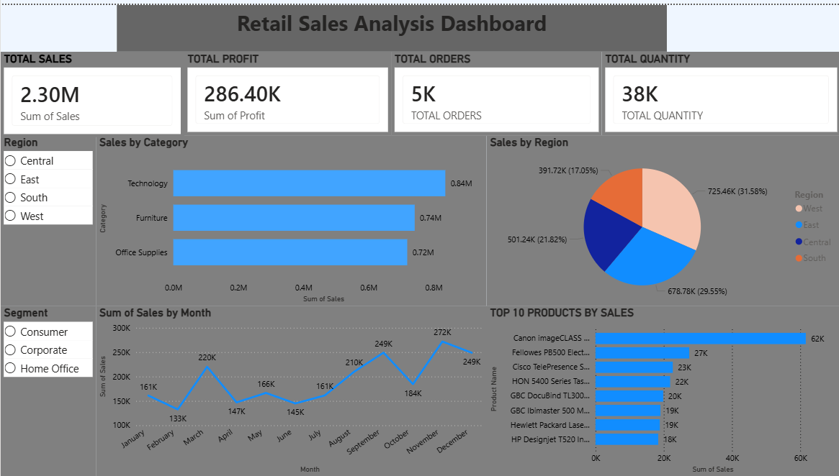
OVERVIEW
CHARTS
1)TOTAL SALES BY CATEGORY
2)SALES BY REGION
3)SUM OF SALES BY MONTH
4)TOP 10 PRODUCTS
SLICERS
1)REGION
2)SEGMENT

Slide 7
KEY INSIGHTS
Technology category generates the highest sales among all categories
West region contributes the largest share of total sales
Sales show an increasing trend towards the end of the year
A few top products contribute significantly to overall revenue
Slicers (Region & Segment) enable dynamic data filtering

Slide 8
CONCLUSION
The dashboard helps in analyzing sales performance and supports better business decisions.
It also provides clear insights into trends, top products, and regional performance.

Slide 9
THANK YOU

